Slide 1
Library Management System

Slide 2
Introduction
Library Management System is a tool which transforms traditional libraries into digital libraries.
It is a brain Power Institute that provides teaching classes for Students.
It is an invaluable source for the education industry.
It helps to keep the records of whole transactions of the books available in the library.
It provides Books for a large number of readers.

Slide 3
Activities
It is the main source for STUDENTS, STAFF and FACULTIES.
It has a huge collection of text books, reference books, etc.
The library provides a peaceful atmosphere.
It provides a source of past years projects, exams and research papers.
Hence, the library is a large source of knowledge.

Slide 4
Advantages
Keeps an accurate record.
Reduces manual work and saves time.
There would be a safe storage of all the information.
There would be a fully computerized system.
With the help of a database any data can be added, modified and deleted very quickly.
Security features are much provided in the system.
User friendly environment.

Slide 5
Overview
Implementation starts with entering and updating master records like Book Details. Library Information. Any further transaction like Book Issue. Book Return will automatically update It Keeps records about how many books available in library and books issued to the students.

Slide 6
Characteristics
We have two levels of users 1. User Side-In user side, user will check the availability of the books. - Book return 2. Administration Side- The following are the sub module in the administration side
- Register user
- Entry book details
- Book issue

Slide 7
Requirements
Functional Requirements: • Book Entry: In this module we can store the details of the books. • Register Student: In this module we can keep the details of the new student. • Book Issue: This module is used to keep the track of book issue details. • Book Return: This module enables to keep a track of returned books.

Slide 8
Requirements
System requirements: • The system should prompt for the user and administrator to login to the application and for proper input criteria. Hardware Requirements: • Operating system: Windows • Hard disk: 500 GB • RAM: 2GB • Processor: intel core-i3

Slide 9
Non Functional Requirements
Safety requirements: The database may get crashed at any certain time due to virus or Operating system failure. Therefore. It is required to take the database backup. Security Requirements: Access rights are decided to prevent from unauthorized access. Hardware Constraints: The system requires a database in order to store the persistent data. The database should have backup capabilities.

Slide 10
Software Requirements
Java Language
Oracle Database

Slide 11
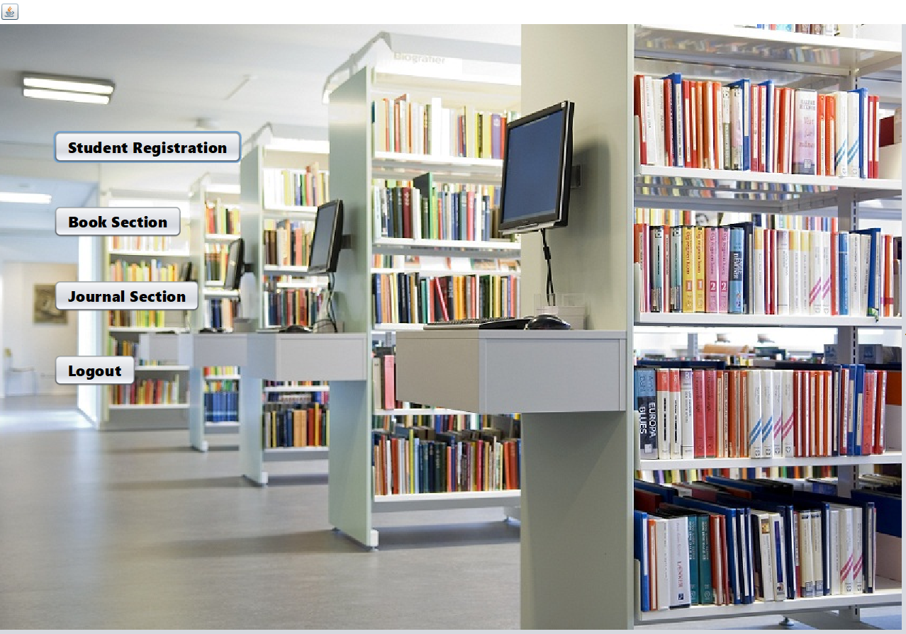

Slide 12
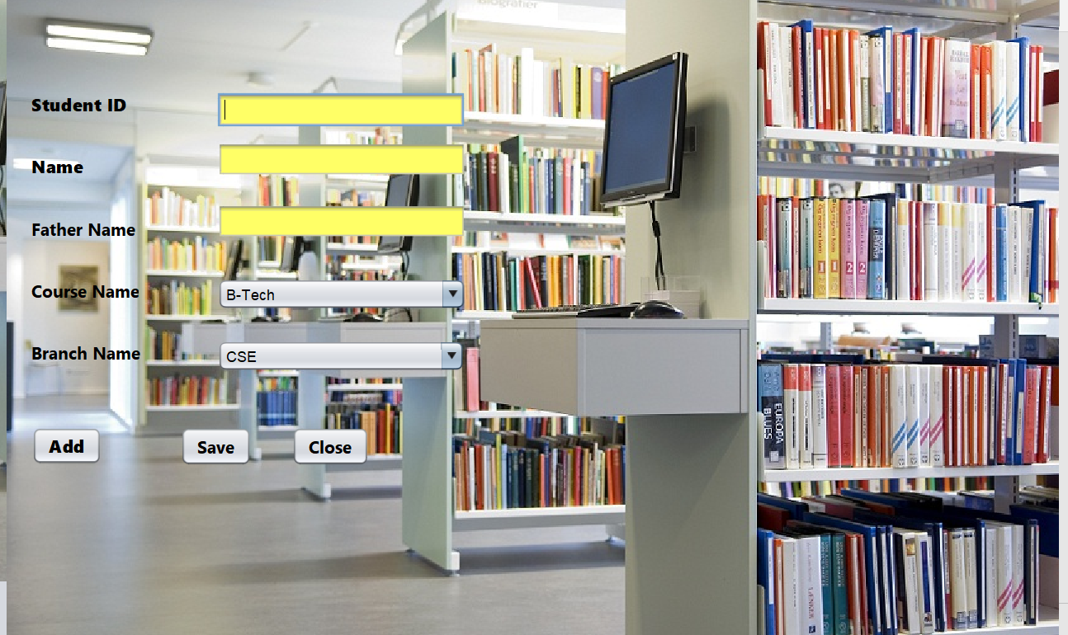

Slide 13
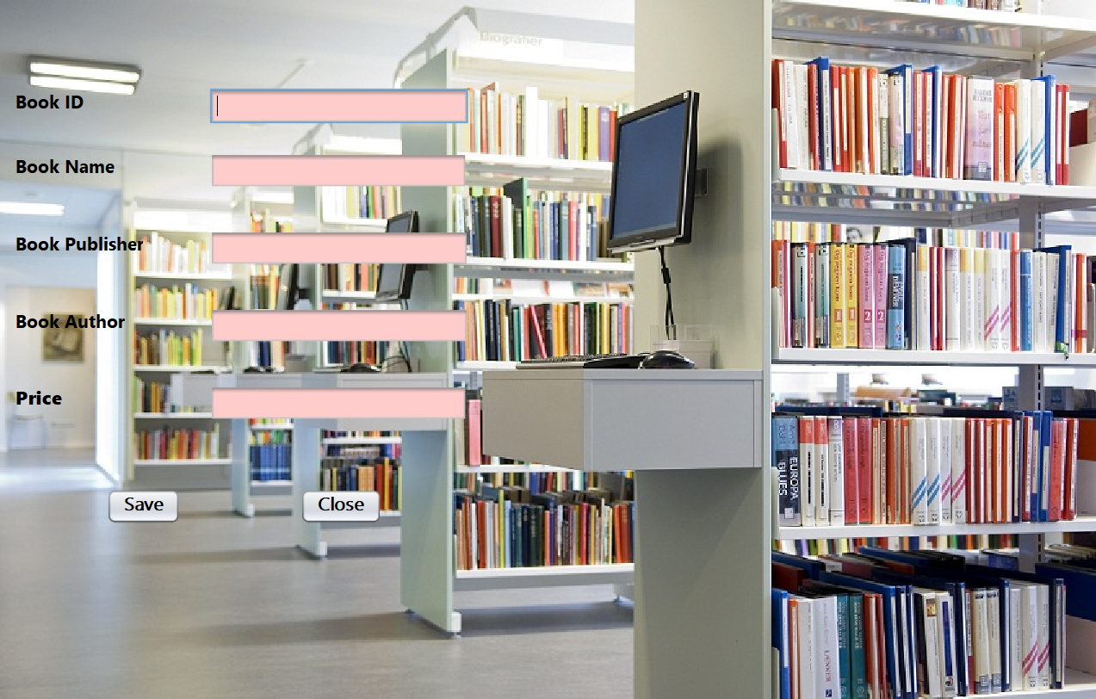

Slide 14
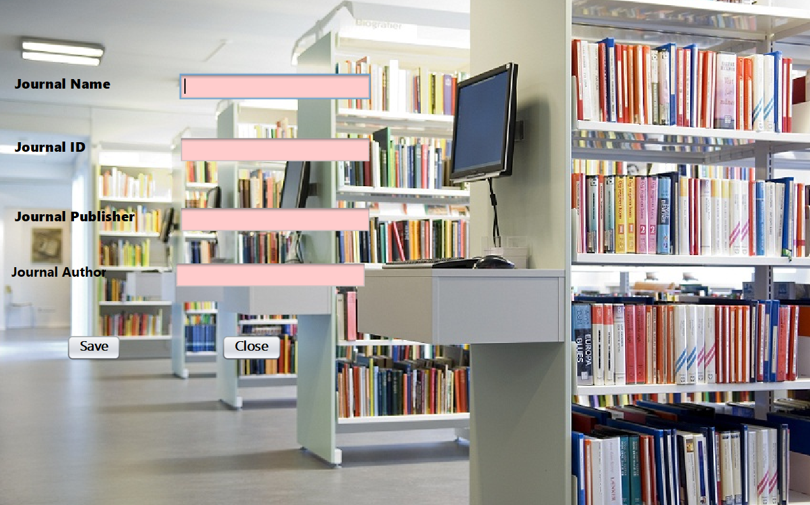

Slide 15
Conclusion
It will take care of the current book detail at any point of time.
The main purpose of this project is to reduce manual work.
The well-developed computerized system is capable of managing books, book issue, book return and calculating fines if the return of the book will get delayed.
Generating various reports for record keeping according to end user requirements.

Slide 16
Thank You!!!

